Slide 1
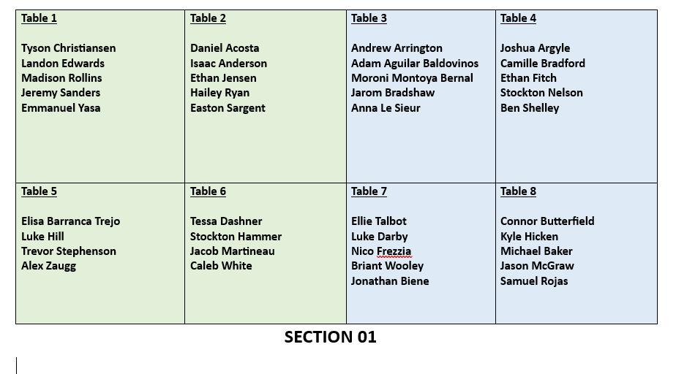

Slide 2
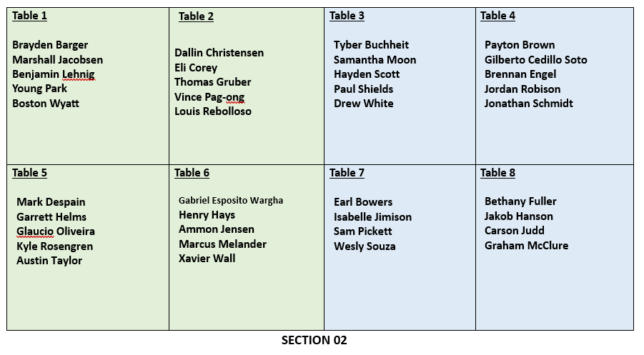

Slide 3
CSE 170 Technical Teamwork Fall 2024
Making you awesome – so you can be a better teammate.

Slide 4
Opening Prayer

Slide 5

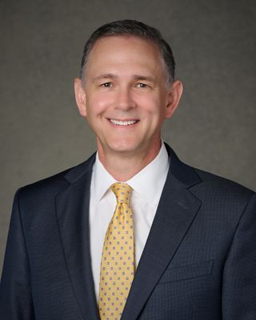
Spiritual Thought
One of the great truths of the Restoration is that the heavens are open—that we too can receive light and knowledge from on high. I testify that is true.
But we must be wary of a spiritual trap. Sometimes faithful Church members become discouraged and even drift away because they haven’t had overwhelming spiritual experiences—because they haven’t experienced their own pillar of light. President Spencer W. Kimball warned, “Always expecting the spectacular, many will miss entirely the constant flow of revealed communication.”
That is the Lord’s typical pattern, brothers and sisters. Rather than sending us a pillar of light, the Lord sends us a ray of light, and then another, and another.
Alexander Dushku – Pillars and Rays – Apr. 2024

Slide 6

Agenda
Self-Awareness
Assignments
Review assignments and due dates
Initial the roll
Myers-Briggs Personalities Discussion
Introversion/Extroversion

Slide 7
Assignments
U02 Prove: User Manual
Using information learned this week, create a “Personal User Manual”.
Share your information with your group.

Slide 8

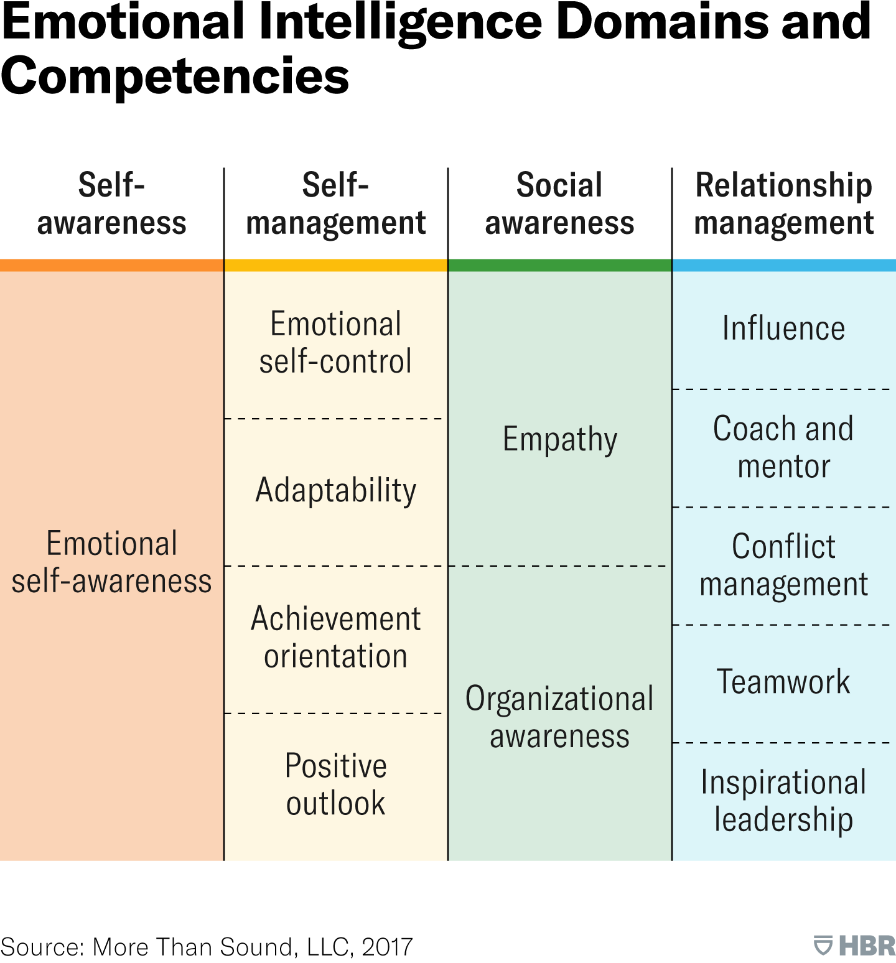

Emotional Intelligence

Slide 9
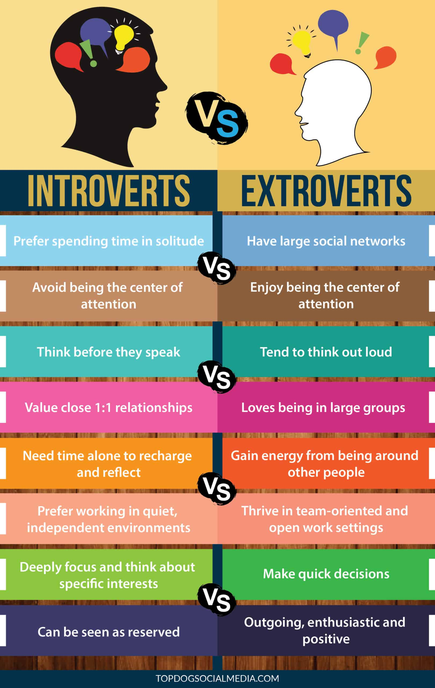
Extravert vs Introvert
What are the key differences between an introvert and an extrovert?
Is it better to be an introvert or an extrovert? Why?
Is it possible to be both an introvert and an extrovert at the same time?

Slide 10

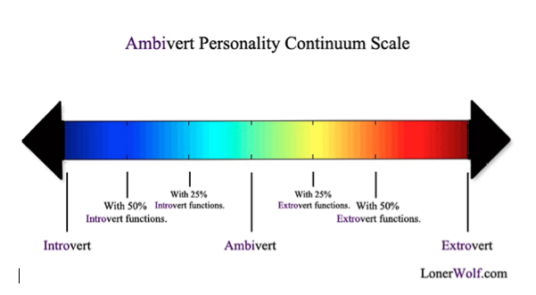

Ambiverts
According to Robert McCrae, a personality psychologist at the National Institute of Aging, ambiverts represent about 38% of the population.
What are the benefits of being an “ambivert”?

Slide 11

A Note of Caution
Our brains are programmed to find simplicity as a shortcut.
We jump to conclusions based on our values, beliefs and biases as well as our past experience.
Personality tests like Myers-Briggs are an attempt to help us simplify our world.
Your test results may change over time as you change as a person.
They can even change based on the time of day!
People are complicated – they cannot be placed in 16 boxes.
This Photo by Unknown Author is licensed under CC BY

Slide 12
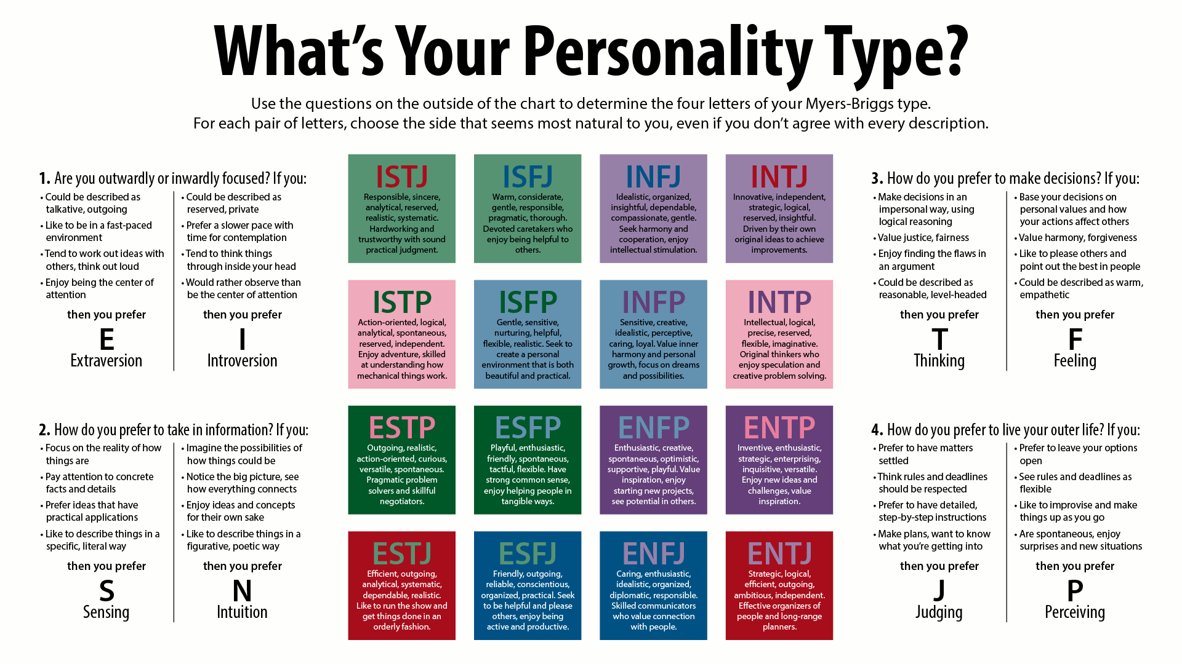

Slide 13
4 Questions
As we explore each type, write down which one you think you are.
We’ll take an online personality test to see if you guessed right.

Slide 14
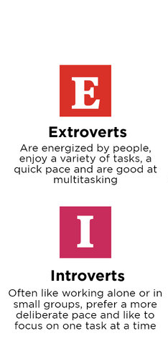
Which are you?

Slide 15
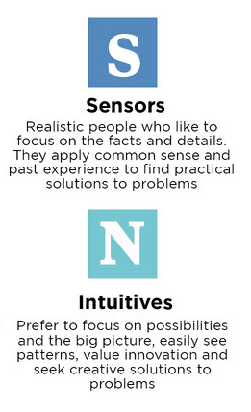
Which are you?

Slide 16
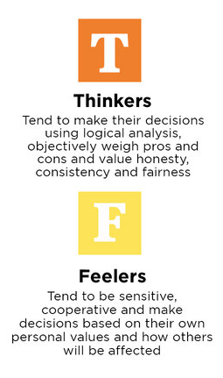
Which are you?

Slide 17
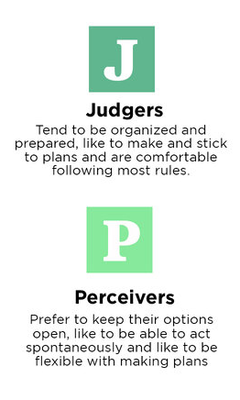
Which are you?

Slide 18
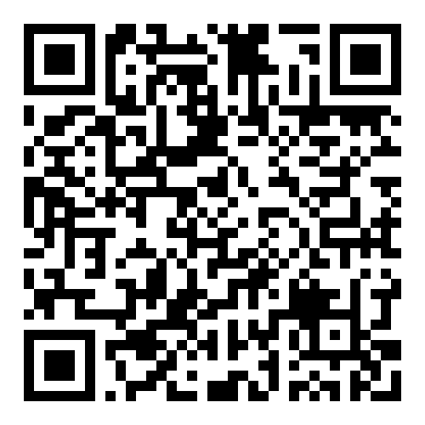
https://www.16personalities.com/free-personality-test
Take the personality test.
In about 10 minutes we’ll discuss the results.
E-mail the results to yourself at the end.
Read through the introduction at the end.
Do your results match what your guess was?

Slide 19
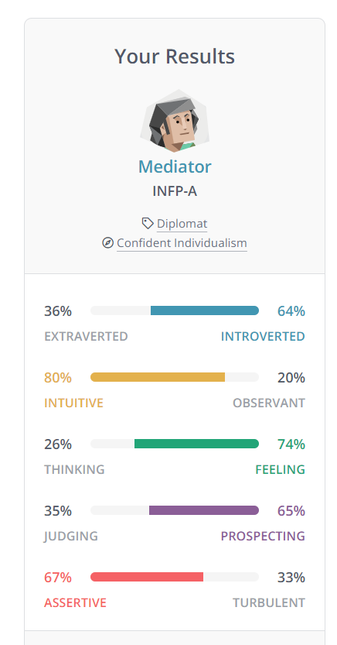
My Personality Type

Slide 20
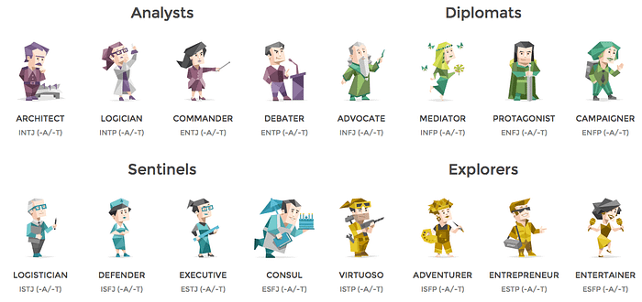

Slide 21

Team Discussion
Each of you share your Personality Type results with the team.
What are some of your tendencies based on the personality test?
CHOOSE A TEAM NAME (adjective animal)
One team member should send reply to the post in MS Teams with your group # and your chosen team name
It can be descriptive like “junkyard dogs” or “rabid raccoons” or “precise penguins”
As a team:
Identify which personalities are likely to mesh well.
Identify which personalities are likely to have conflicts.

Slide 22

Next Time
Your Personal User Manual

